Slide 1
I GOT 2 F’s!!!!!!
Family and Food
By Stephen Giang

Slide 2


My Sister
This is my Sister, Theresa Pham.
She is 24 years old, born and raised in San Diego, and is Bilingual in English and Vietnamese
She is also a San Diego State Alumni with a BS in Kinesiology
We are both 3 quarters Vietnamese, 1 quarter Chinese.
We have 3 dogs, because she is a huge dog lover.

Slide 3
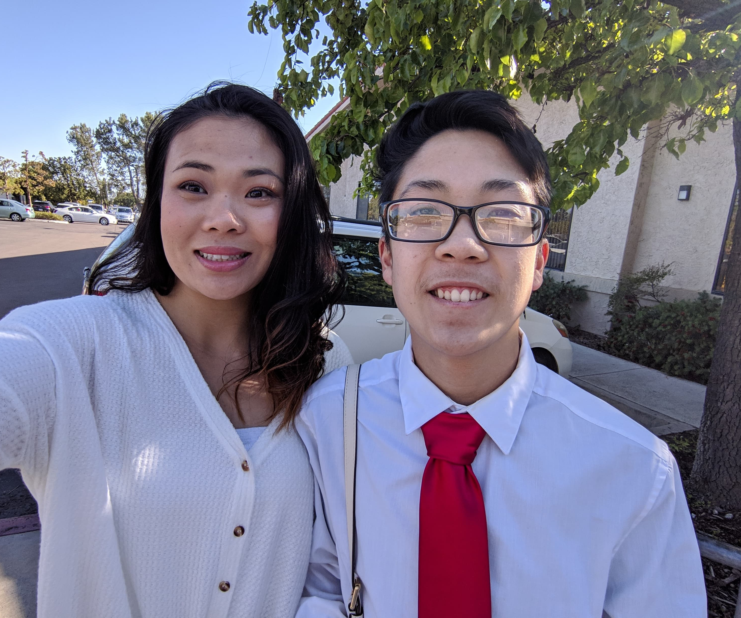
Food in Her Life
“What major cooking practices and values did you experience as you were growing up”
“I grew up in a home where Mom was always cooking in the morning and night. She prepared meals before going off to bed. We always had a protein, whether it be fried fish, Vietnamese marinated steak, or crispy pork belly. Along with that was always a bowl or rice, and maybe finish it off with a warm soup. So rice, meat, and soup was my staple growing up.”

Slide 4
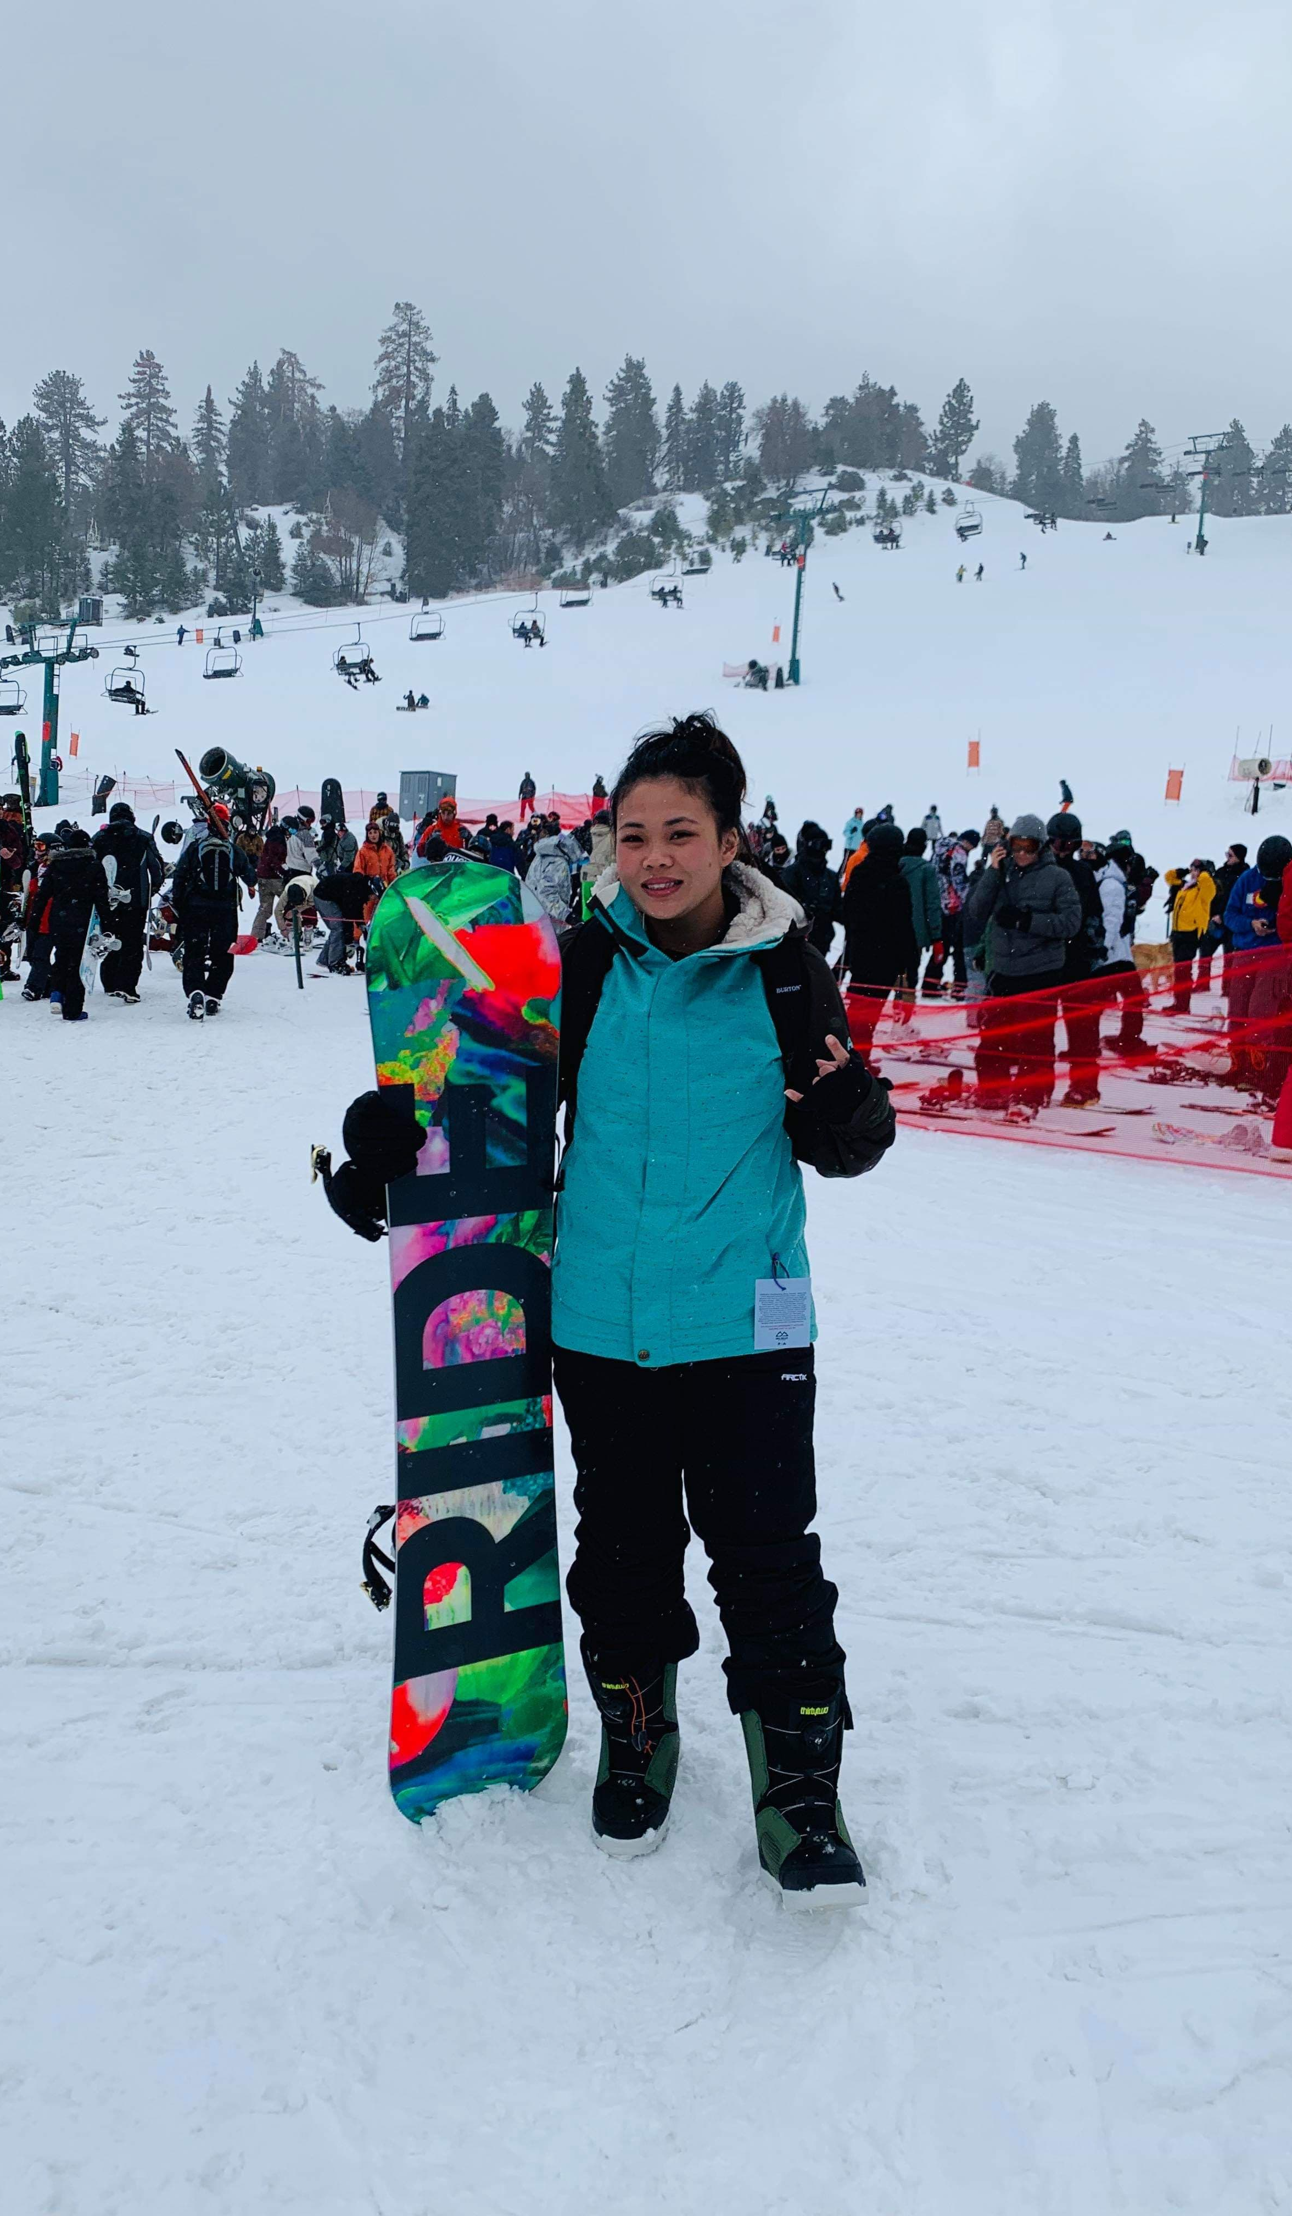
“How do your experiences differ from what is considered a common cooking practice today?”
“Well to start, most people no longer use a wok, or not use salt. Back then, everything was cooked in a wok, like fried rice or beef or chicken stir fry. In addition, Mom does not use salt in her cooking. Instead, she uses salt substitutes, like the natural salts in meat or in fish sauce, which is also a huge staple in our cooking. Also, Mom cooks her beef broth from real beef bones, and cooks it for hours overnight, instead of using the pre-packaged beef broth. She uses that when cooking pho, a Vietnamese Noodle Dish.”
Food in Her Life

Slide 5
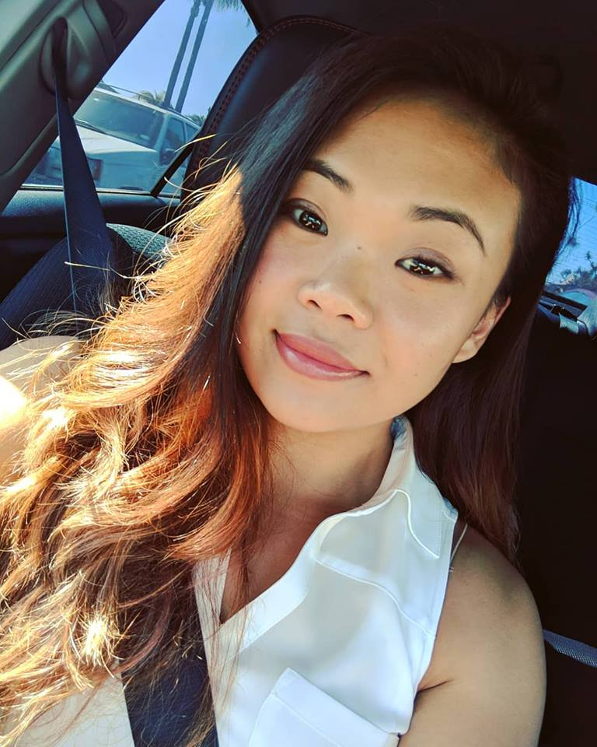
Food in Her Life
“How did the way you were raised affect your food choices and cooking practices today?”
“I was raised to always put effort in my cooking, to take no shortcuts. I cook pho every now and then, and when I do, I always make the beef broth from scratch because it creates a more warm and homey taste and feel. In our foods, I saw that a lot of Vietnamese food was centered around “sweet” meats. Which is not technically like candy sweet, but we do use a lot of sugar in our foods. And that has stuck with my pallet. I actually prefer a sweeter tasting meat dish. Mom used to cook Spam with onions and add sugar and fish sauce and it would be the best. I cook that late at night when I'm hungry. In addition, I cannot really handle the taste of raw salt, like when they put salt on fries. I guess its because we never used it at home. So till this day, I don’t need to add salt to my food.

Slide 6

Food in Her Life
“What was the importance of having a healthy meal?”
“Healthy food was a huge part of our lives. We tried to reduce the amount of oil we used in our cooking, along with having a homecooked meal for every meal. We also always had our carbs from rice, protein from meat, vegetables with our soup, and fruit for dessert. We had the entire food pyramid every meal. We also never drank soda, but instead drank milk once a day. Doing this, helped us keep a faster metabolism and let us be more active in the day.

Slide 7
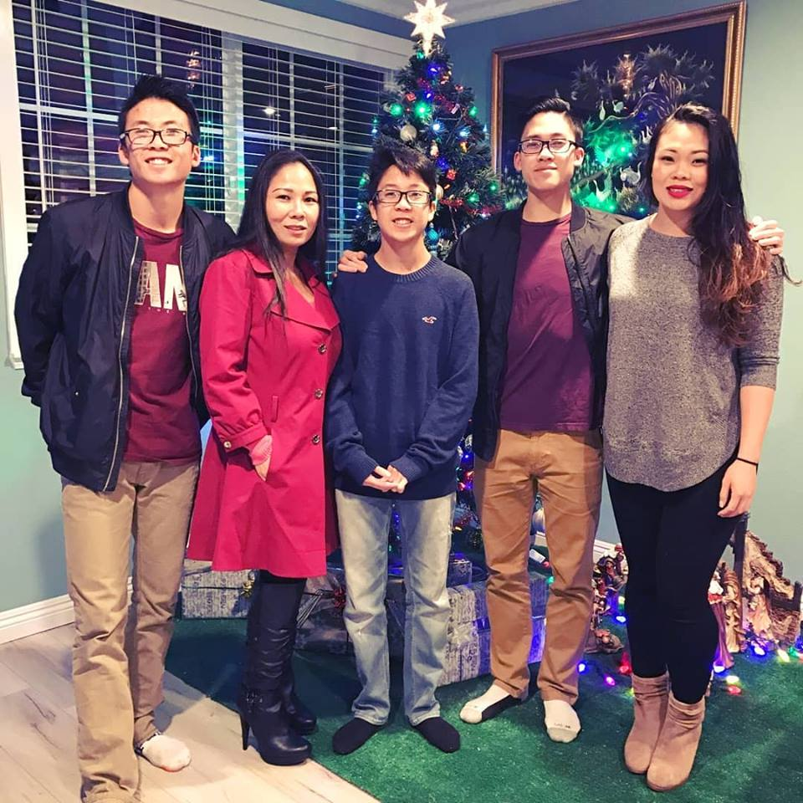
Food in Her Life
“What are some healthy substitutes they recommend for our cooking methods today”
“Instead of making egg rolls that are fried, we can use an Air fryer. Also, we can substitute the entirety of egg rolls, with spring rolls. We can also substitute the white rice, with a brown rice or quinoa.”

Slide 8
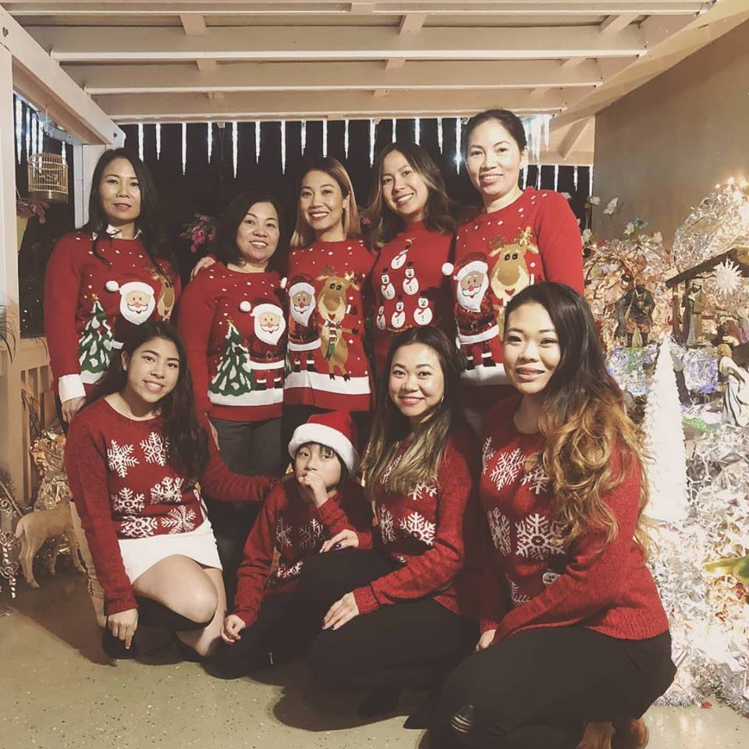
“How prevalent were Vietnamese traditions in your life regarding the food aspect?”
“Being a San Diego Native, I am able to experience a ton of other cultures, while experiencing my own at home. As I did experience a lot of Vietnamese traditions in the food I ate, like rice and pho. But I was also able to experience foods like Burritos, Curry, Ramen, Pasta. I think when I was younger, It was much more prevalent, but has since then become lesser and lesser”
Food in Her Life

Slide 9
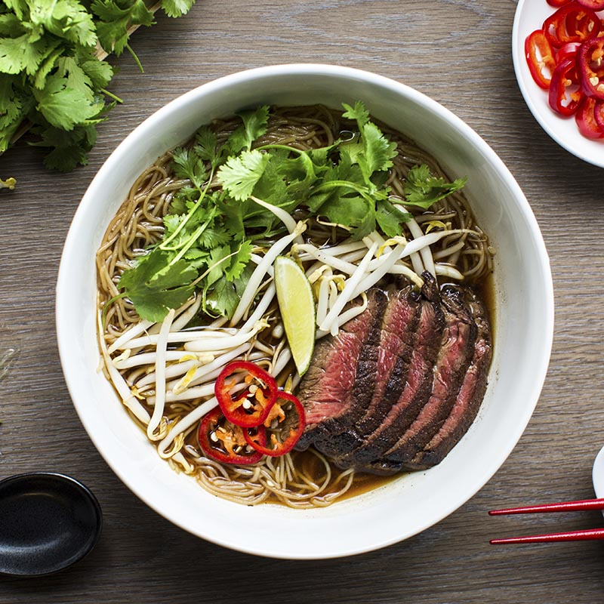
How to Make Pho

Slide 10
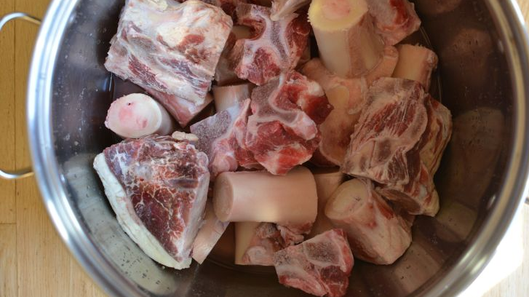
To A Pot Add…
Cleaned Off Beef Leg Bones.
Make Sure to have all the Fatty Bone Marrow
That will be the greatest treat in your pho
This will also be the base for our Beef Pho Broth.
With the Bones, we also want to keep a little meat on it, so that we have little meat chunks in the soup.

Slide 11
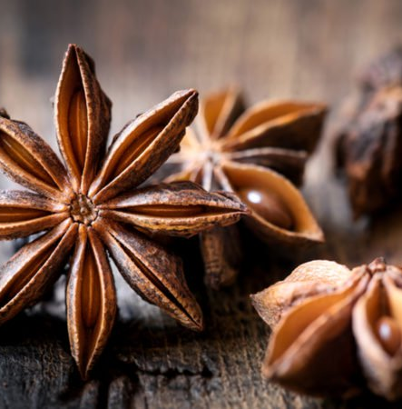
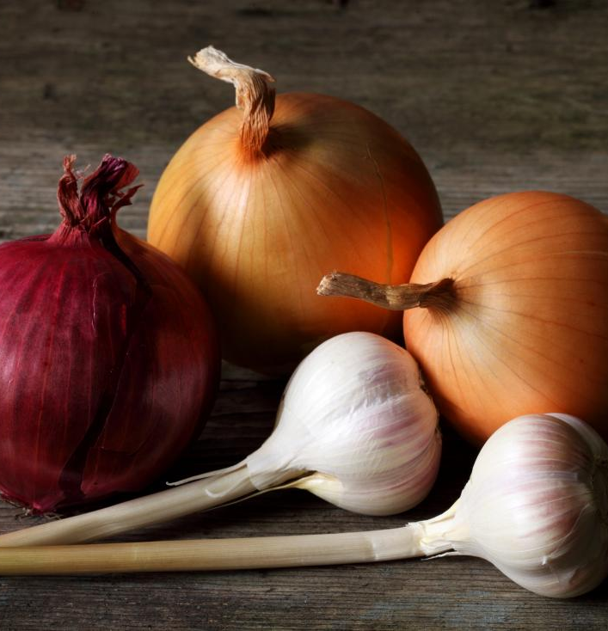
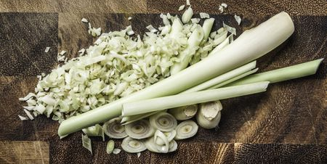
To the Same Pot Add…
A Cheesecloth of
Black Peppercorns
Star Anise
Lemon Grass
Roasted Onions, Ginger, and Garlic

Slide 12
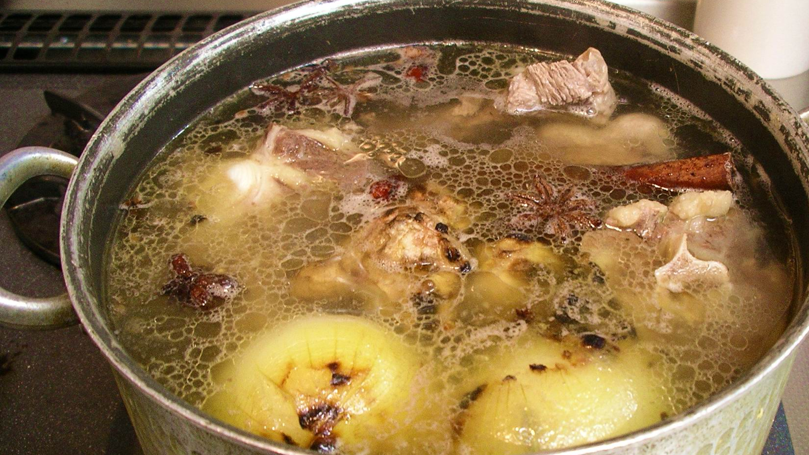
Sit …. And Wait
Now we add the Water
Let simmer overnight, or approximately 12 hours
By letting it simmer over night, all the flavors can become more concentrated in the soup
Skim the Broth periodically as the gunk from all the bones will rise. Skim and remove all the impurities from the soup for a clean hearty broth.

Slide 13
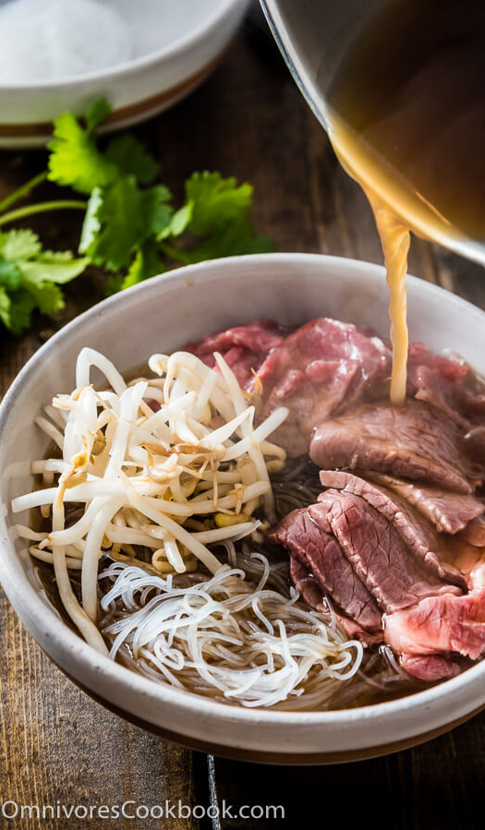
Putting the Bowl Together
Boil Rice Noodles for a minute
They Cook a lot faster due to their thin nature
To the Bowl, add…
Raw thinly sliced beef brisket
Shredded Onion
Green Onions
Vietnamese Meatballs
Beansprouts
The Delicous Soup

Slide 14
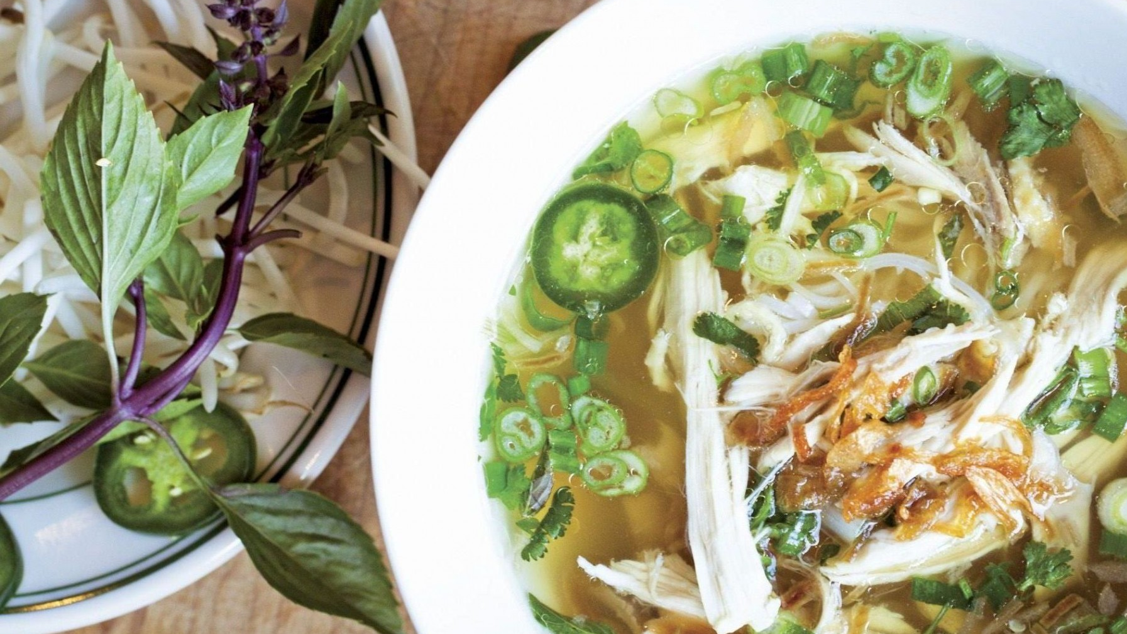
How to Make Pho Healthier
Instead of Making Pho Bo (or Beef Pho)
Try Pho Ga (Chicken) or Pho Do Bien (Seafood)
By doing this, we are cutting down on the red meats, as well as using leaner forms of protein.
It makes the soup and the meats that come along with it, more leaner and healthier, instead of the heartier beef alternative.

Slide 15
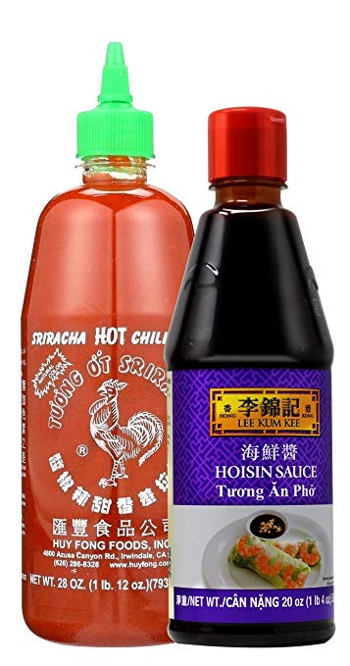
How to Make Pho Healthier
Don’t use the Condiments
Pho Usually comes with 2 condiments
Hoisin Sauce
A sweet and savory soy bean paste.
It contains a high amount of sodium and sugars
Sriracha
A spicy sauce made of chili peppers, garlic, and vinegar.
It also contains a high amount of sodium and sugars

Slide 16
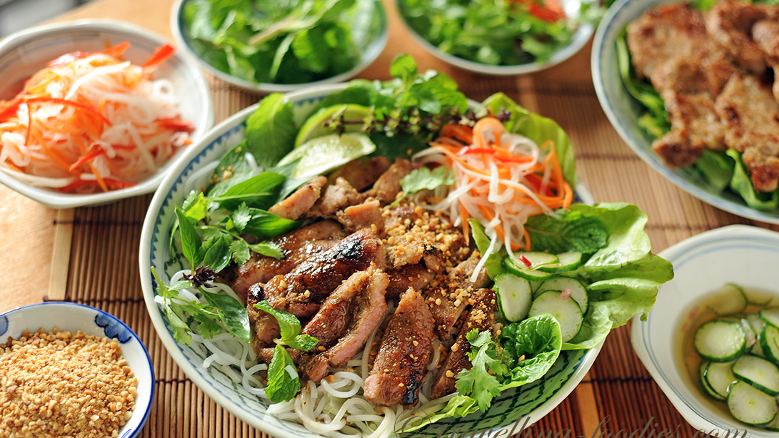
Reflection
I learned from this project exactly how my culture has affected my likes and dislikes towards certain foods.
My culture is a huge factor in what I like and I don’t like. For example, because I ate rice so much as a child (every meal), I very much dislike white rice.
One thing that has stuck with me is the fact that I too like sweet meats. A nice sweet protein like lobster or a sweet glaze with some steak are my favorite foods.
Who I am is linked to my culture, and my culture is very much embodied through its food. The way you eat, the utensils you use, the art on the bowls all link to exactly how I react to foods.

